Slide 1
Brushless Motors
What you need to know.

Slide 2
Motor selection info.
Watts per pound of airplane weight.
  100w/lbs = trainer/sport
  150w/lbs = 3D aerobatics
  200w/lbs = extreme
Watts = volts * current
  7.4v * 10amps = 74watts
  11.1v * 25amps = 277watts
  22v * 50amps = 1110watts
Ex. 16oz sport airplane = 100w motor
746watts = 1 horse power

Slide 3
Motor formulas
Efficiency: Motor Efficiency = Pout/Pin, Pout = (Vin - Iin * Rm) * (Iin - Io)
Motor Kv: Kv = RPM / (Vin - Vloss), Vloss = Iin * Rm
Motor RPM: RPM = Kv * (V - Vloss), Vloss = Iin * Rm
Watts: Watts = V * Iin, Alternately P=I²R (P = I x I x Rm)
Stalled Motor: Istall = Vin / Rm
Torque constant: Torque constant: Kt=Kb x 1.345, Kb = Voltage constant (Volt/1000 RPM)
Torque Loss: Torque = Kt * (Iin - Io)
Termination: Wye = the number of winds you have performed, Delta = divide the number of turns by 1.73
Watts per Horsepower: 1 horsepower = 746 watts
Kv-Rpm constant: Kv * turns = motor constant, (ex. Kv=1090 * 32T ~= 35000 so, 35000/28T ~= 1250Kv)

Slide 4
Motor formulas - Acronyms
Acronyms:
Rm = Resistance value of the motor, derived from the guage of wire used.
Pout = Power Out of the Motor expressed in Watts
Pin = Power In of the Motor expressed in Watts
Vin = Voltage Into the Motor
Iin = Current Into the Motor
Io = Noload Current of the Motor, derived from running a motor WOT without a prop at varying voltages. Io can be expressed with an associated Voltage and should be.
Kv = K value or voltage constant, the expressed value where the rpm can be surmised by a given voltage. For a 2000 Kv motor an input voltage of 10V would net 20000RPM.
Istall = The load current of a motor which is purposely stalled, hence not turning.
Kt = Torque constant (oz-In/A)
Kb = Voltage constant (Volt/1000 RPM)

Slide 5
Misc. motor info.
PI*(dia./2)^2) = sectional area of wire
~ Delta > Star = .578 (.562 - .526)
~ Star > Delta = 1.73 (1.78 - 1.9)
Doubling the number of winds halves Kv (rpm/volt) and doubles Kt (torque/Ampere),
Doubling stator height halves Kv, doubles Kt and (roughly) doubles maximum power.
Kv-Rpm Constant:
Example:
The 3008-32 motor has a Kv of 1090. If you take 1090 x 32 you get 34,880. If you look at the 3008-28 motor, it has a Kv of 1253.
If you take 1253 x 28 you get 35,084. Based on these 2 numbers, you can see that the constant for the 3008 size motor is right arounf 35,000.
If you take 35,000 and divie that by the number of turns, you will get the approximate Kv of the motor.

Slide 6
Brushless motor construction
The basic 3-phase build

Slide 7
Why build?
Fun
Cheap
Rewarding
Build the perfect motor for your application.

Slide 8
Electronic Gearing
Divide 360deg by number of magnets then divide by 3 phases.
  This provides the degree of movement per step sequence.
6 cycle step sequences needed to complete 1 revolution of the magnetic field.
  A to B / C to B / C to A / B to A / B to C / A to C
Examples:
10 magnet
360deg / 10 mag = 36deg || 36deg / 3 phase = 12deg
(12deg / step) x 6 steps = 72deg. Sequence
360deg / 72deg = 5 or 5:1 gearing
14magnet
360deg / 14 mag = 25.71deg || 25.71deg / 3 phase = 8.57deg
(8.57deg / step) x 6 steps = 51.42deg. Sequence
360deg / 51.42deg = 7 or 7:1 gearing

Slide 9
9-pole magnet options
9-pole stator basically two choices:
  6 magnets (3:1 gearing)
    High RPM (Kv), low torque
    Good for Helis and ducted fans
  12 magnets (6:1 gearing)
    Low RPM (Kv), high torque
    Larger propellers, 3D flying

Slide 10
12-pole magnet options
12-pole stator four choices:
LRK or DLRK wind
  10 magnets (5:1 gearing)
    Higher RPM (Kv), lower torque
  14 magnets (7:1 gearing)
    Lower RPM (Kv), higher torque
  ABC wind
  8 magnets (4:1 gearing)
    Higher RPM (Kv), lower torque
  16 magnets (8:1 gearing)
    Lower RPM (Kv), higher torque

Slide 11
Wind techniques / options
9-pole stator can only be wound using ABC wind
  ABC - ABCABCABC
12-pole stator can be wound either ABC, LRK or DLRK.
  ABC – ABCABCABCABC (easy, need more magnets)
  LRK – A-b-C-a-B-c (high wrap count per tooth, less to wind)
  DLRK – AabBCcaABbcC (low wrap count per tooth, more to wind

Slide 12
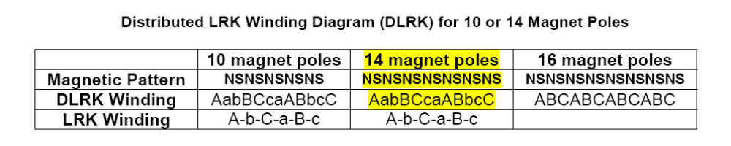
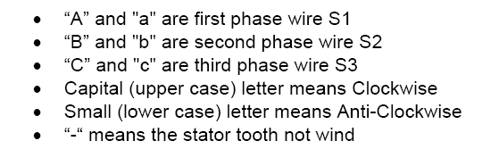
12 stator pole wind types

Slide 13
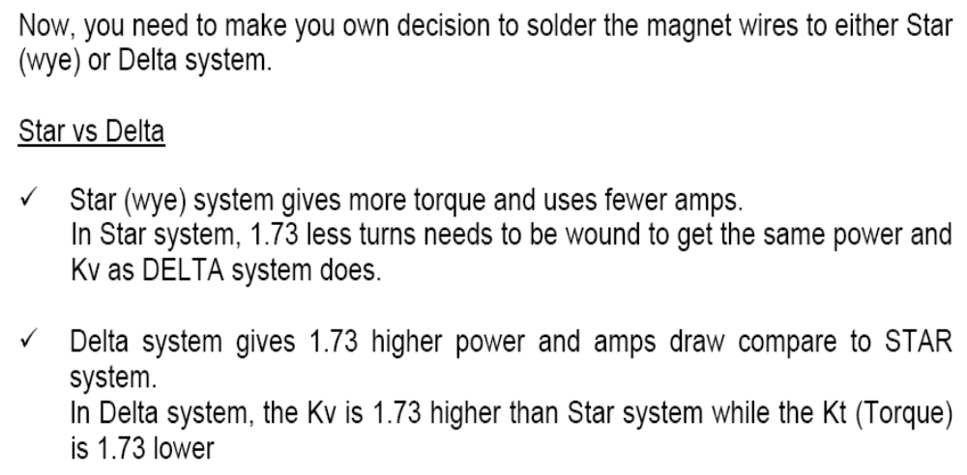
Star or Delta connection?

Slide 14
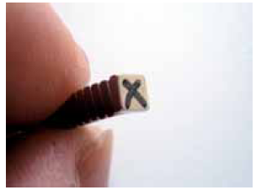
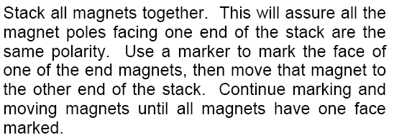
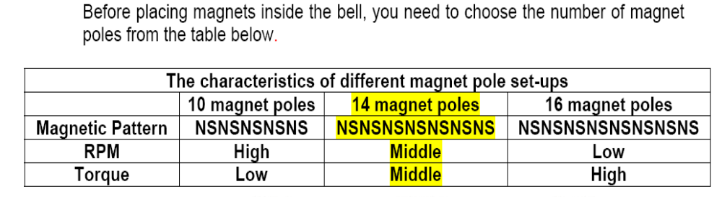
Magnet polarity

Slide 15
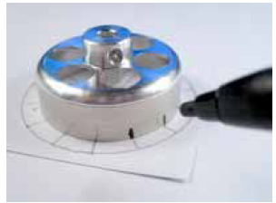
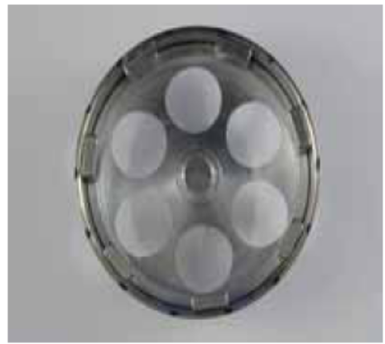
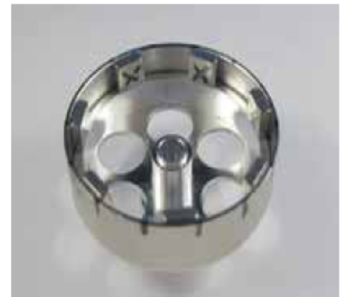
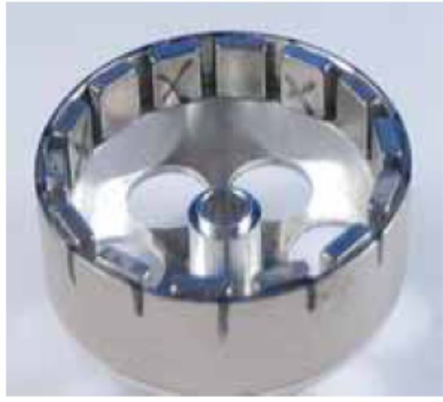
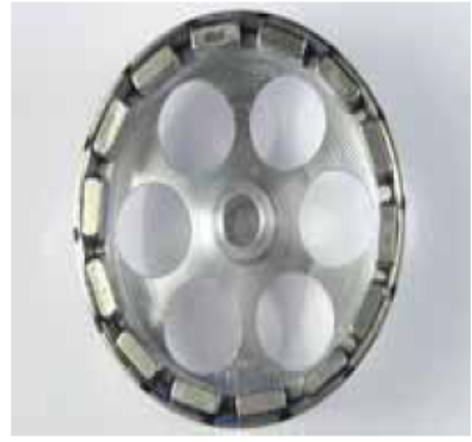
Magnet installation

Slide 16
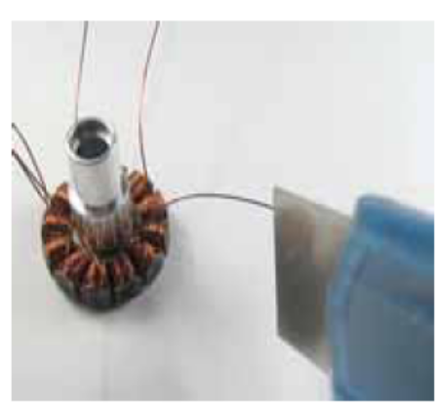
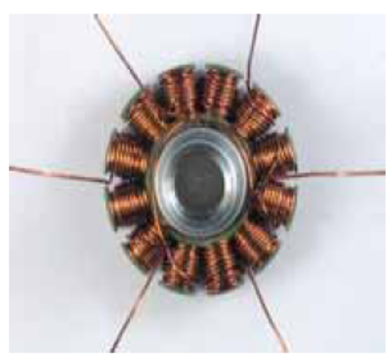
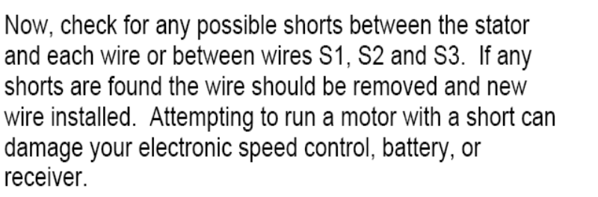
Check for shorts – Solder wires

Slide 17
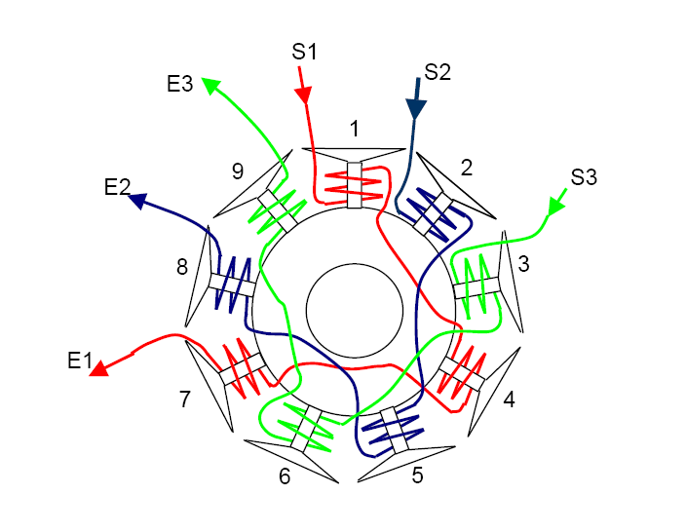
9-pole stator – ABC wind

Slide 18
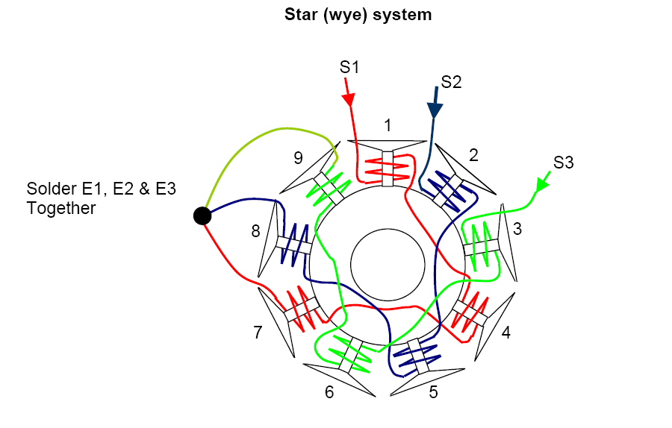
9 pole “Star” connection

Slide 19
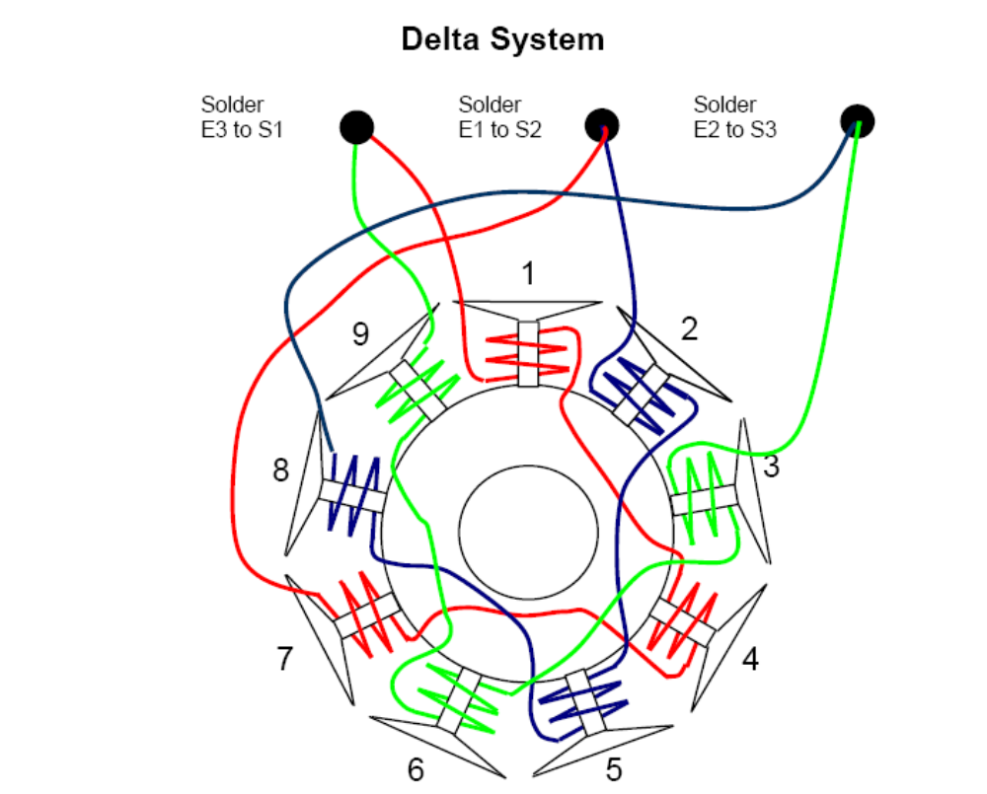
9 pole “Delta” Connection

Slide 20
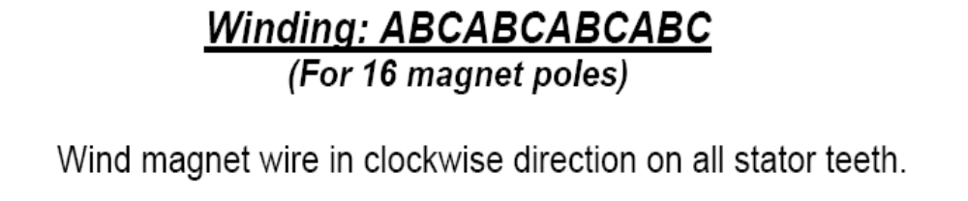
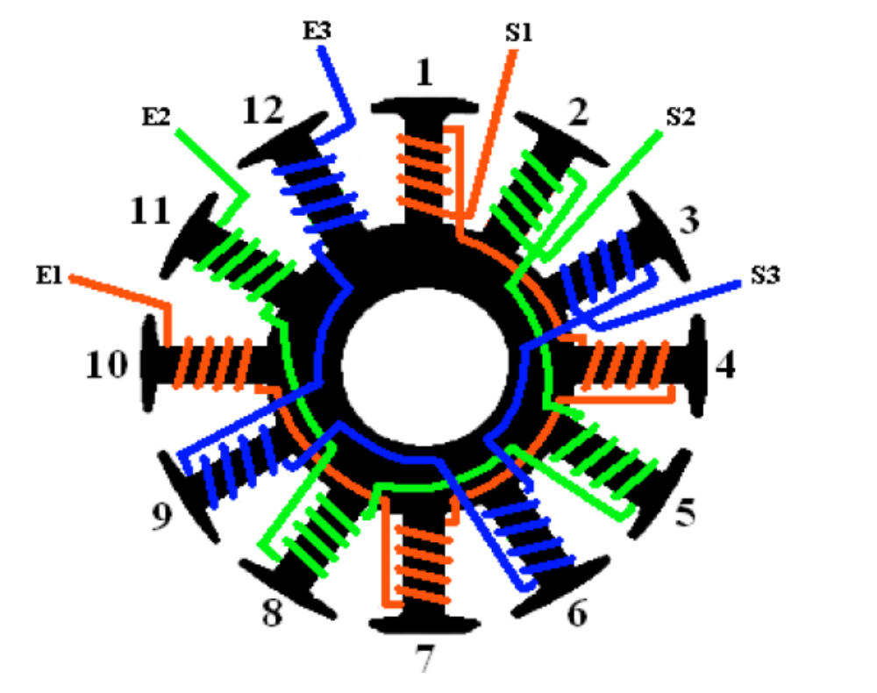

Slide 21
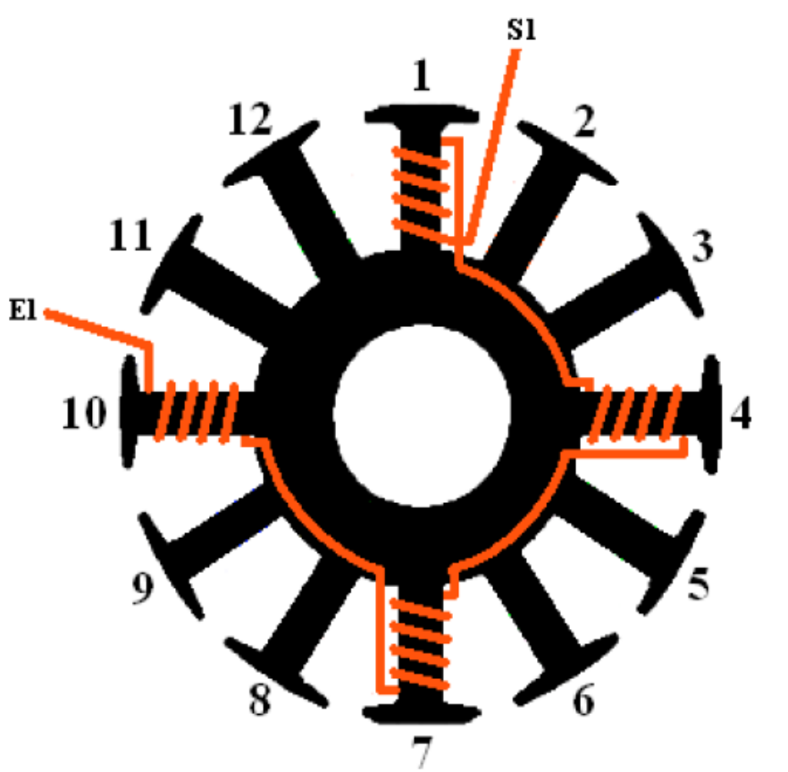
Phase A of the ABC wind 12-pole, 8 or 16-magnets

Slide 22
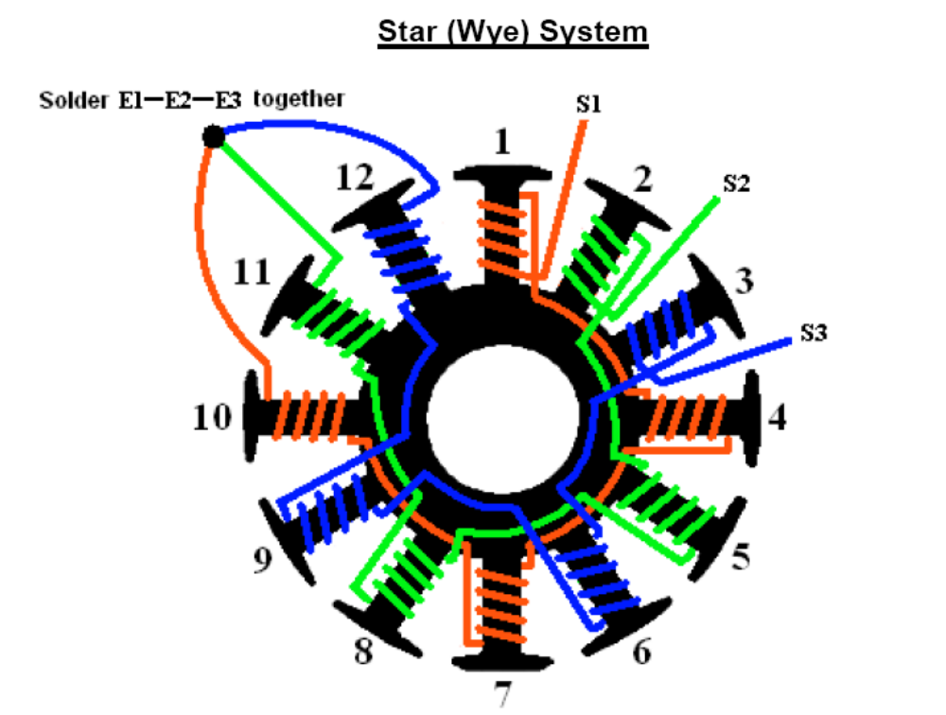
12 pole ABC “Star” Connection

Slide 23
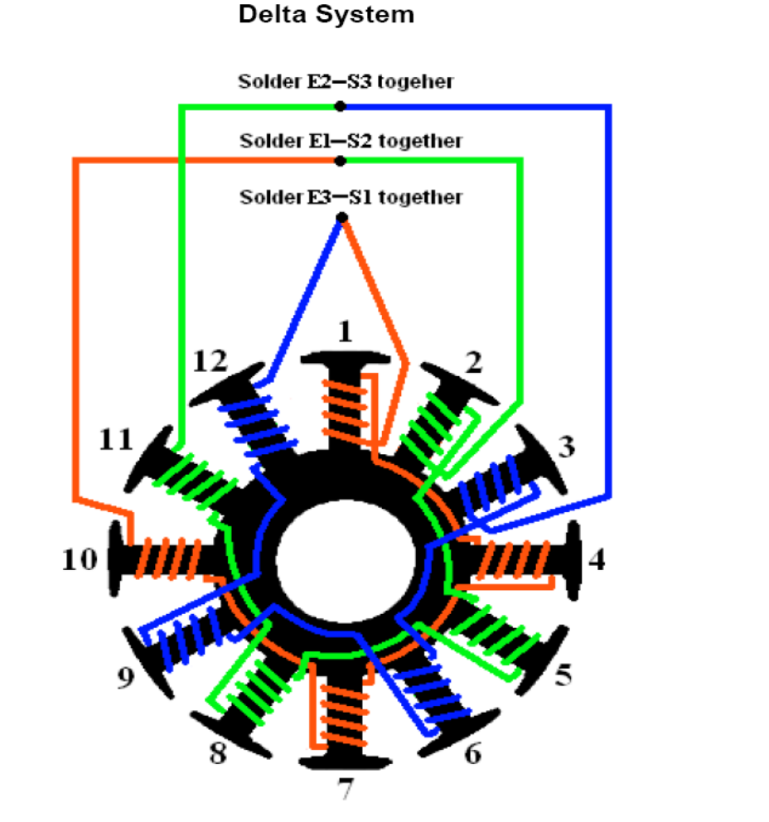
12 pole ABC “Delta” Connection

Slide 24
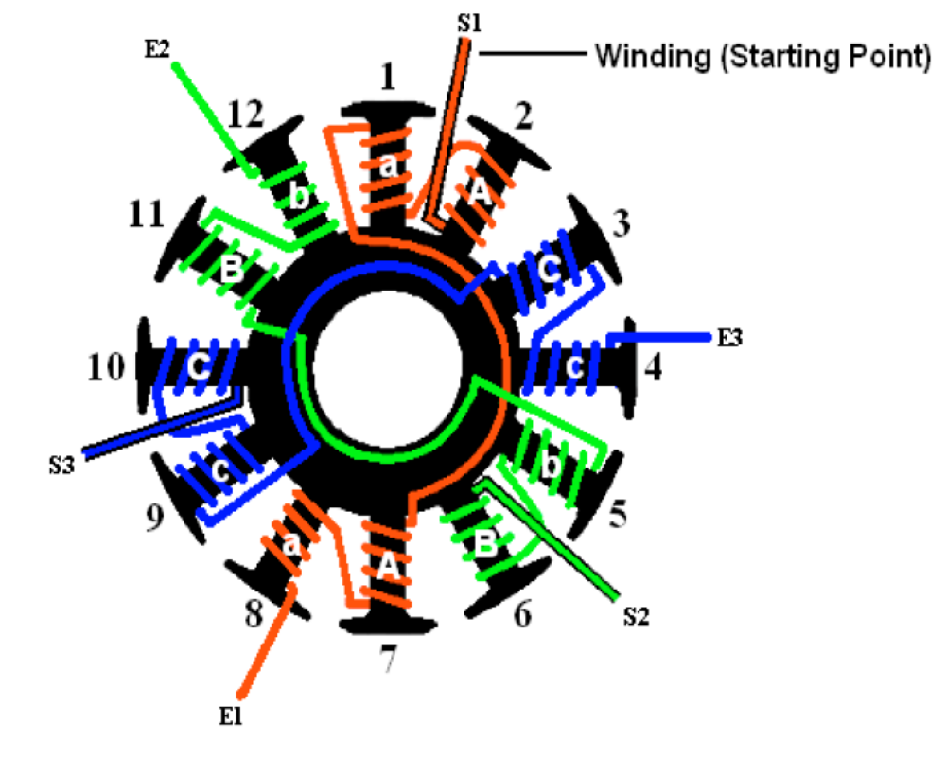
Distributed LRK winding diagram for 10 or 14 magnet poles.

Slide 25
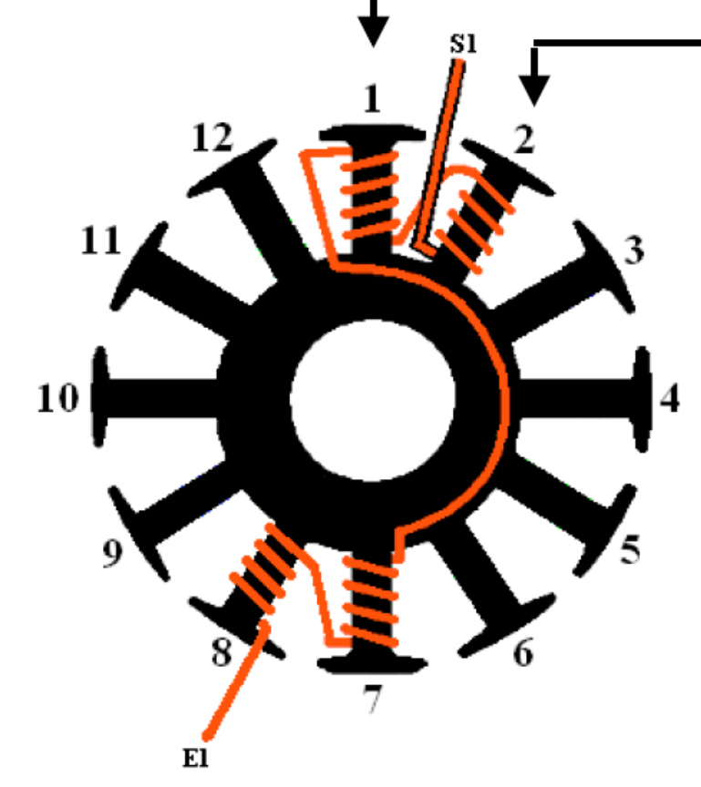
Phase A, DLRK wind

Slide 26
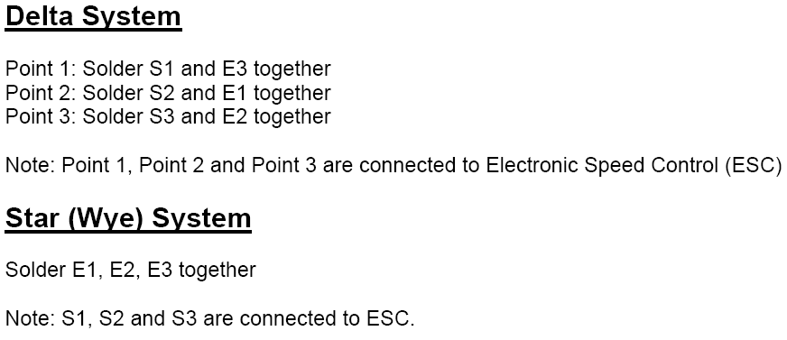
LRK or DLRK

Slide 27
Resources:
www.innov8tivedesigns.com
  Scorpion motors / kits
www.gobrushless.com
  Motor kits
www.komodohobby.com
  Motor kits
www.rcgroups.com
  Excellent source of information.

